Slide 1
Employee Data Analysis using Excel
STUDENT NAME: YUVARANI V.R
REGISTER NO:312216821 /9CC1993B91FA8A09973478FBCB264F53
DEPARTMENT:B.COM(Accounting and Finance)
COLLEGE: Shri Krishnaswamy college for women

Slide 2
PROJECT TITLE
Employee Performance Analysis using Excel

Slide 3


AGENDA
Problem Statement
Project Overview
End Users
Our Solution and Proposition
Dataset Description
Modelling Approach
Results and Discussion
Conclusion
3/21/2024 Annual Review

Slide 4

PROBLEM STATEMENT
To enhance office space utilization and improve employee satisfaction, we need to delve into the geographic distribution of employees and their work preferences. The ultimate goal is to optimize office locations and remote work arrangements based on data-driven insights.

Slide 5

PROJECT OVERVIEW
.
Human Resources (HR) Managers
Talent Acquisition teams
Work force planners
Operation managers
Business intelligence teams
Location manager
Risk management teams

Slide 6

WHO ARE THE END USERS?
Retailers
Real estate proffessionals
Urban planners and local government
Transportation and logistics companies
Health care provides
Financial services

Slide 7

OUR SOLUTION AND ITS VALUE PROPOSITION
Conditional Formatting – Missing value
Filtering – remove Blank cells
Formula – performance for (=IFS(Z8>=5,”VERY HIGH”,Z8>=4,”HIGH”,Z8>=
3,”MED”,TRUE,”LOW”)
PIVOT TABLE – summarizing data set
Graph –data visualisation

Slide 8
Dataset Description
Employee Data set source – Edunet Dashboard
Total 27 Features
4 features used
Business unit
Performance level
Gender
First Name

Slide 9

THE "WOW" IN OUR SOLUTION
Conditional formatting – in that I deleting the blank and empty cells
Formula for analysing the employee performance using the formula
=IFS(Z8>=5,”VERY HIGH”,Z8>=4,”HIGH”,Z8>=3,”MED”,TRUE,”LOW”)
3/21/2024 Annual Review
9

Slide 10
MODELLING
DATA COLLETION I collected the data from EDUNET dashboard load the collected data to Excel.
FEATURE COLLECTION Collected the Feature about the employee data such as Business unit, performance level, Gender, First name
DATA CLEANING
Missing Values: Data may have missing entries due to various reason like error in data collection or merging dataset from different sources
Detection: Identify missing values using functions
Handling Missing values:
There are Several Strategies Removal: remove rows or columns with missing value if they are not critical.
SUMMARY Here I give the summary about the employee performance level and I visualizing
The data using the pivot table and create the graph
VALIDATION Validation is a process of data analysis using the excel include the pivot table.
10

Slide 11
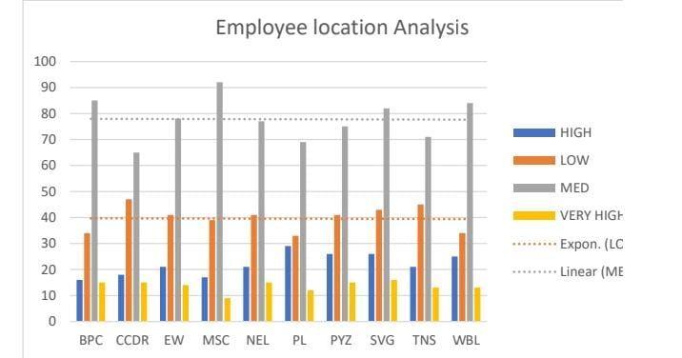
RESULTS
11

Slide 12
conclusion
Employee Performance is a corner stone of an organizational success. By effectively managing and Evaluating performance , organization can ensure that their work force is productive , engaged and aligned with the companies strategical goals regular performance assessment provide valuable insights into employee strength And area for improvement , enabling targeted development better resources allocation and more informed decision making.

